Slide 1


Beyond Metadata for BBC iPlayer
An autoencoder-DRIVEN APPROACH FOR EMBEDDING GENERATION IN CONTENT SIMILARITY RECOMMENDATIONs
Simone spaccarotella
18TH NOVEMBER 2024

Slide 2
Beyond Metadata for BBC iPlayer
An autoencoder-DRIVEN APPROACH FOR EMBEDDING GENERATION IN CONTENT SIMILARITY RECOMMENDATIONs

Slide 3
Introduction
Who I am and what my technical background is

Slide 4



Introduction

Slide 5

Area of Research

Slide 6
Project ideas
Use of Contextual Data in personalized recommendations
Play pattern and interaction pattern analysis
Sequential recommender system
Use of Passport tags to improve recommendations
Item representation with Autoencoders
Multi-product recommendations

Slide 7
Project ideas
Use of Contextual Data in personalized recommendations
Play pattern and interaction pattern analysis
Sequential recommender system
Use of Passport tags to improve recommendations
Item representation with Autoencoders
Multi-product recommendations

Slide 8
Project ideas
Use of Contextual Data in personalized recommendations
Play pattern and interaction pattern analysis
Sequential recommender system
Use of Passport tags to improve recommendations
Item representation with Autoencoders
Multi-product recommendations

Slide 9
Project Overview
a high-level summary of the main aspects of the project

Slide 10
What I built
A machine learning pipeline
content-to-content (C2C) similarity recommender
video-on-demand (VOD)
"More Like This" section on BBC iPlayer

Slide 11
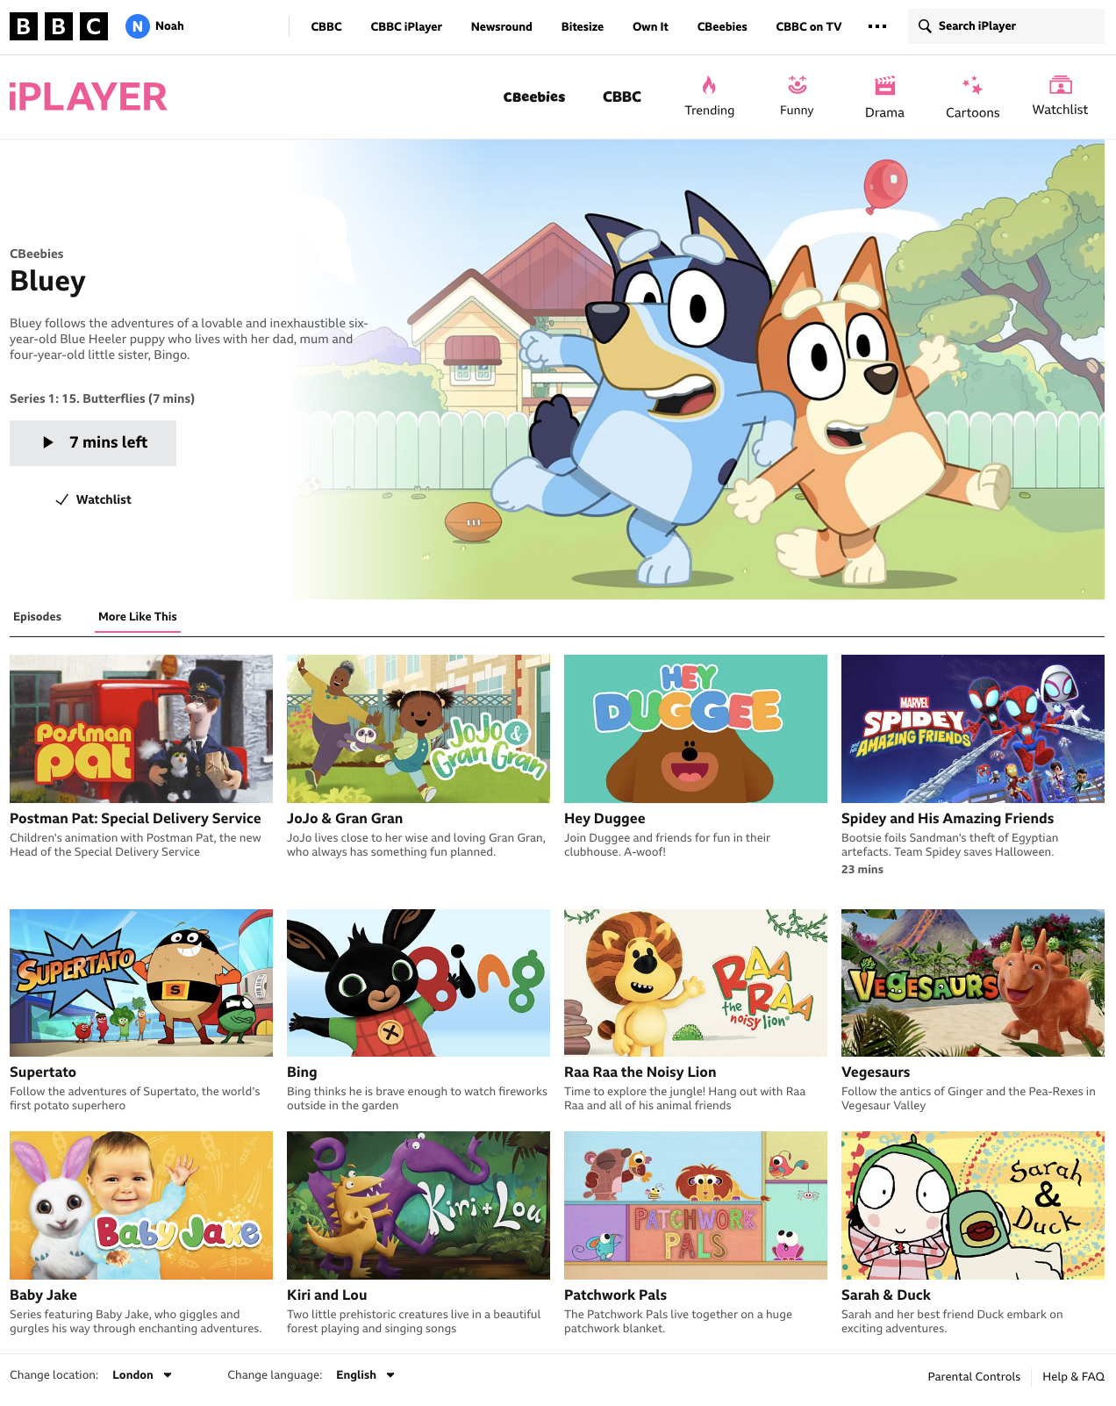
“More like this”

Slide 12
Why this project?

Slide 13
Potentials
Improve the quality of the recommendations
Provide a common embeddings generator for content metadata
Reduce costs and duplications
The what

Slide 14
Contributions
Ingested a feature-rich dataset that better describe the content
Applied novel techniques to improve the descriptive power of the transformed content metadata
The how

Slide 15
Motivations
Improve on the identified issues
Learn and apply novel ML techniques
Align with the business objectives and needs
The why

Slide 16
Issues with the current solution
Feature poor
Lack of preprocessing
Suboptimal similarity scoring
Hardcoded parameters

Slide 17
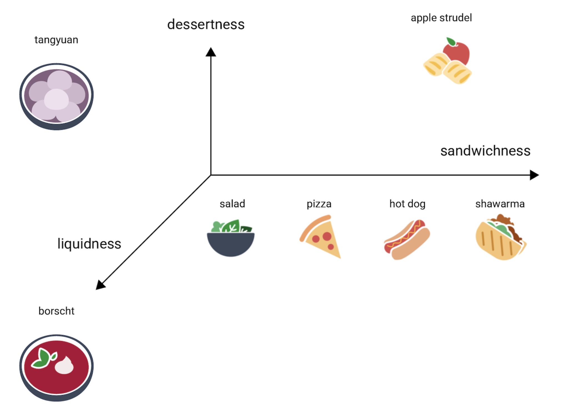
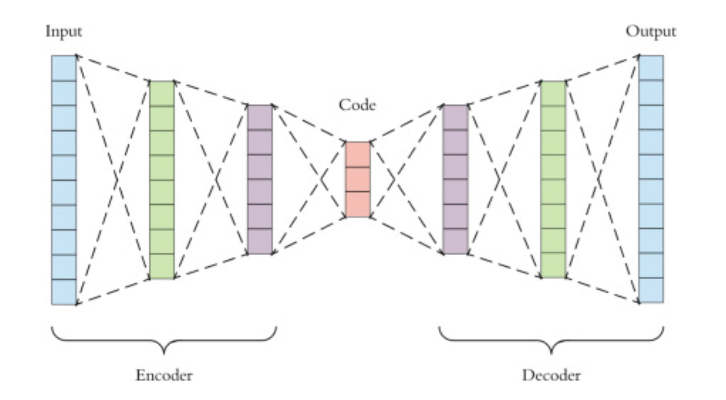
Techniques

Slide 18



Business Objectives and Needs

Slide 19
Measure of Success
Key performance indicators and scope of the project

Slide 20
Key Performance Indicators
Integration with Passport Tags
Comparability of the recommendations with the current solution

Slide 21

Business Objectives and Needs

Slide 22
Cost Reduction

Slide 23
Potential cost reduction
C
/
Linked to the Passport integration and adoption of the solution
N

Slide 24
User Engagement

Slide 25
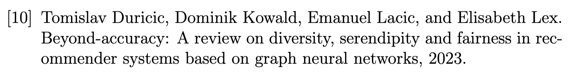
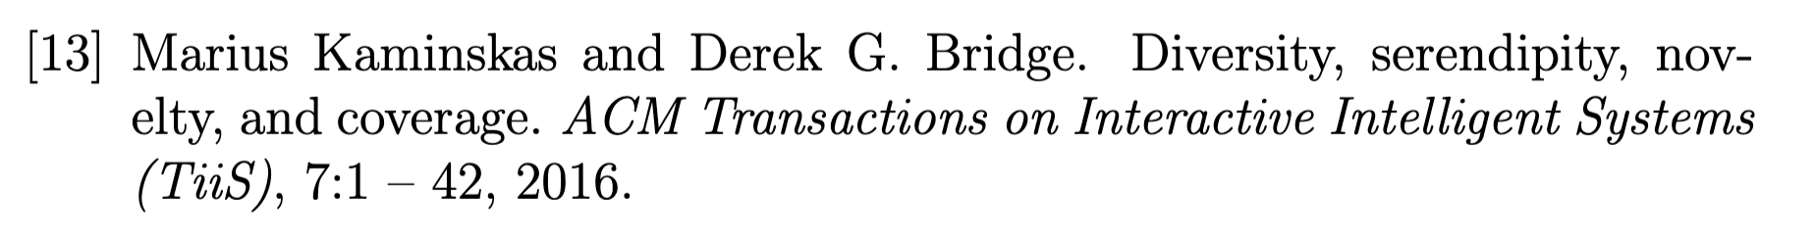
User Engagement

Slide 26

Diversity
A Measure of variety within similarity recommendations

Slide 27
Diversity
Metadata Diversity
Genre
Format
Contributor
Motivation
Editorial Tone
Narrative Theme
A Measure of variety within similarity recommendations
Relevant To
About

Slide 28

Diversity
A Measure of variety within similarity recommendations

Slide 29

Out of Scope
A/B test experimentation

Slide 30
In Scope
Proprocess the data
Train and validate a model
Generate and visualize the recommendations
Build an MVP
Share the results with stakeholders

Slide 31
The Main Intuition
The idea behind the solution

Slide 32
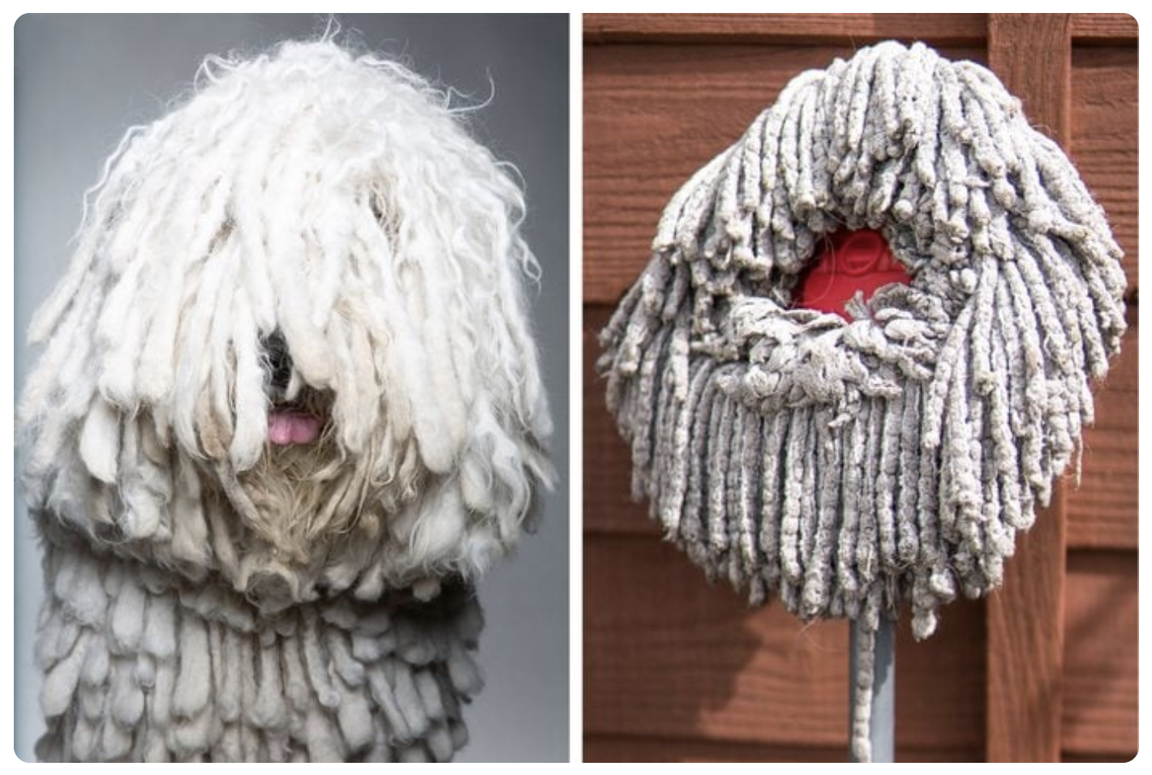
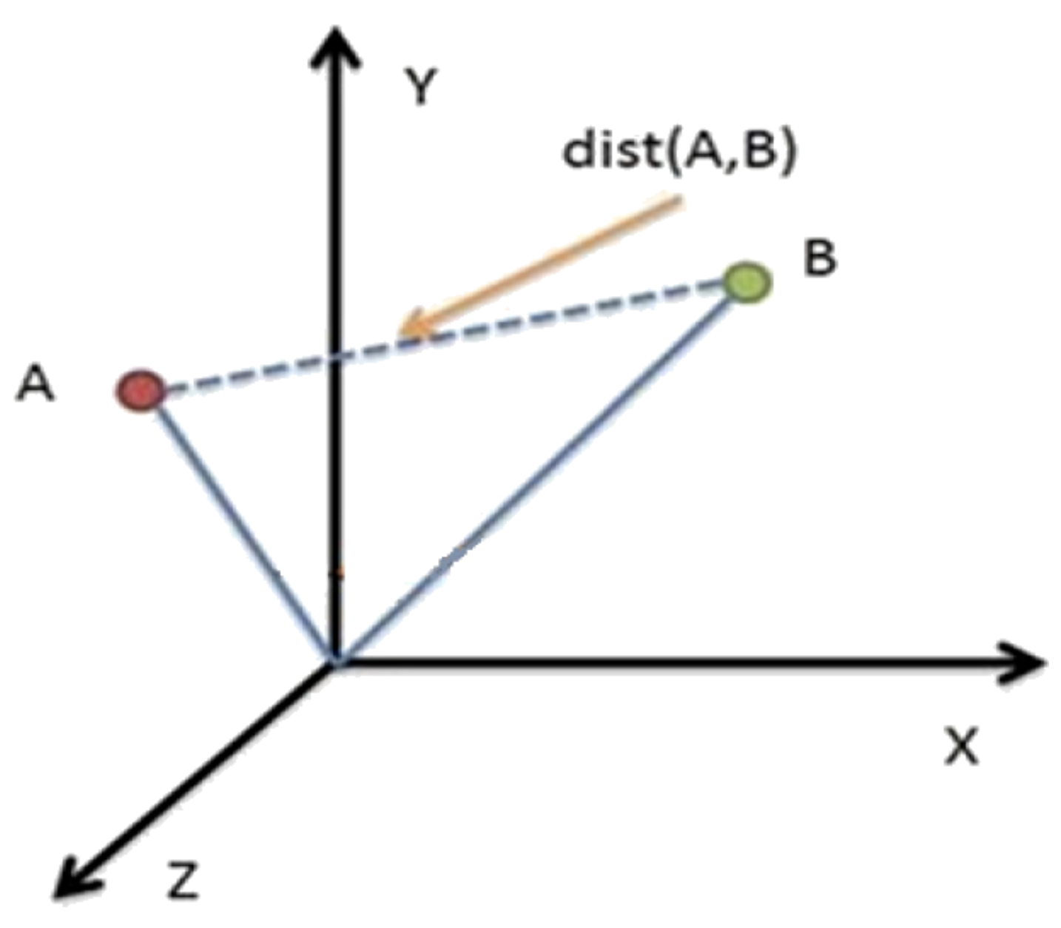
The Main Intuition
Similarity
Distance in space

Slide 33
The Data
An overview of the iPlayer catalogue and the data structure

Slide 34

Main Idea

Slide 35

Main Idea

Slide 36
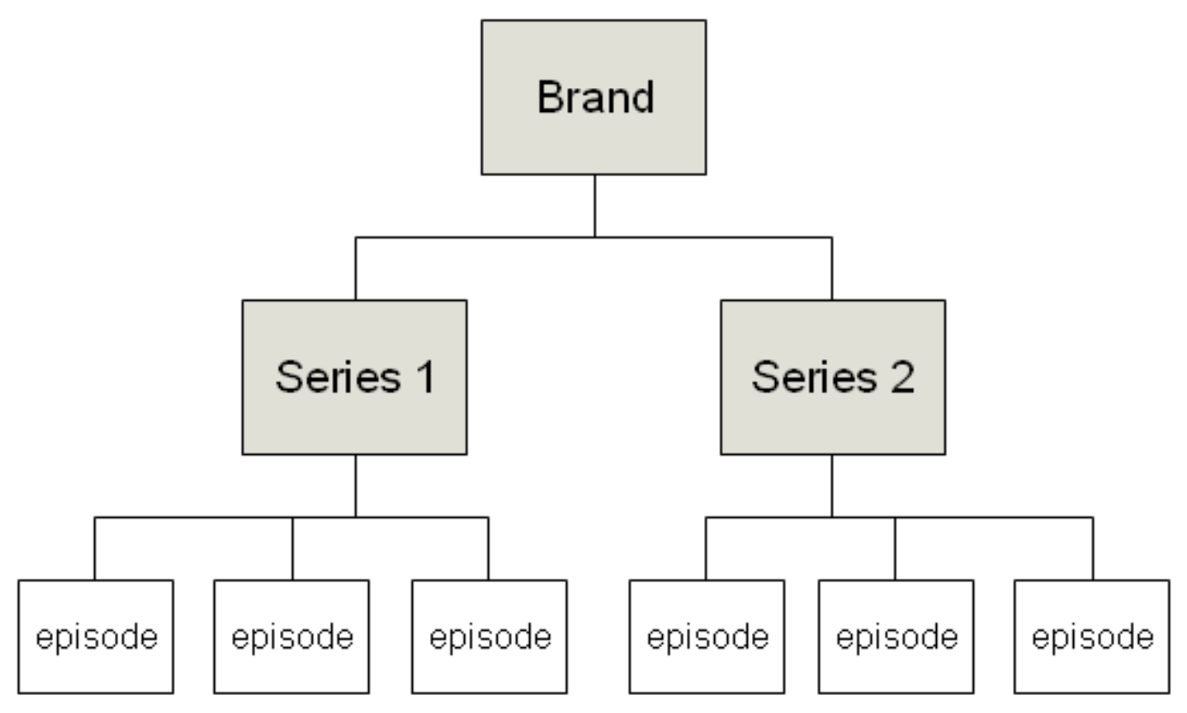
The Data
The iPlayer programmes structure

Slide 37
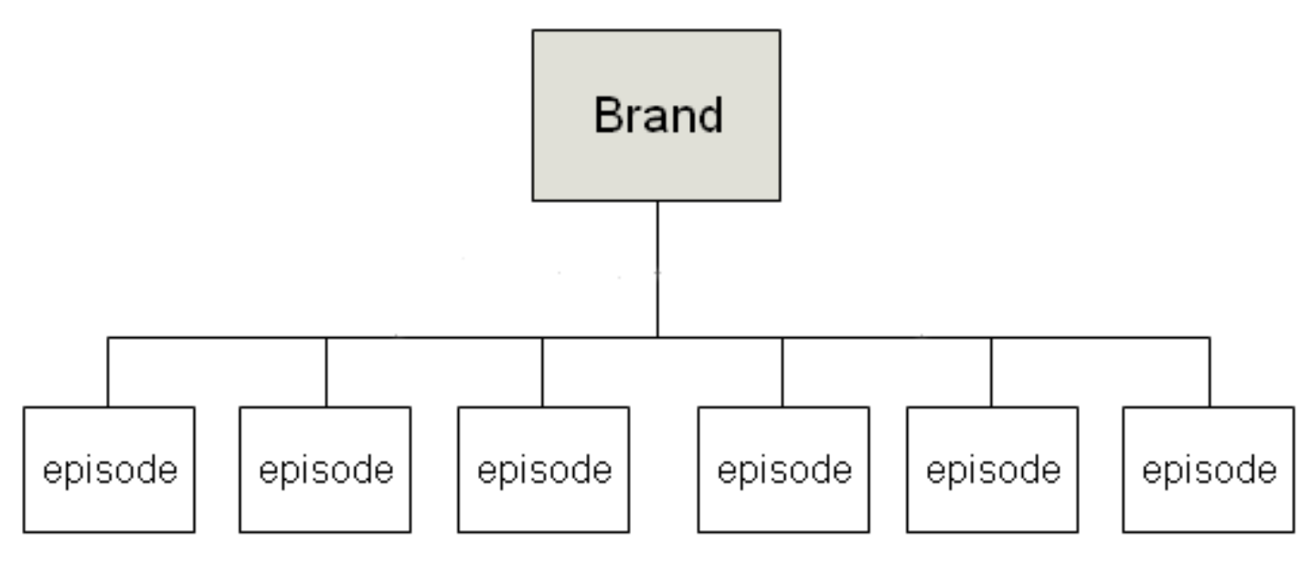
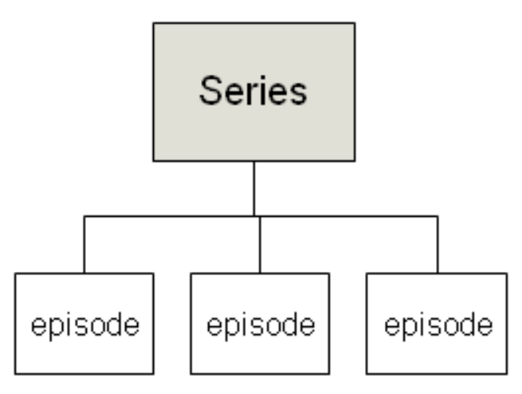
The Data
The iPlayer programmes structure

Slide 38
The Data
episode
The iPlayer programmes structure

Slide 39
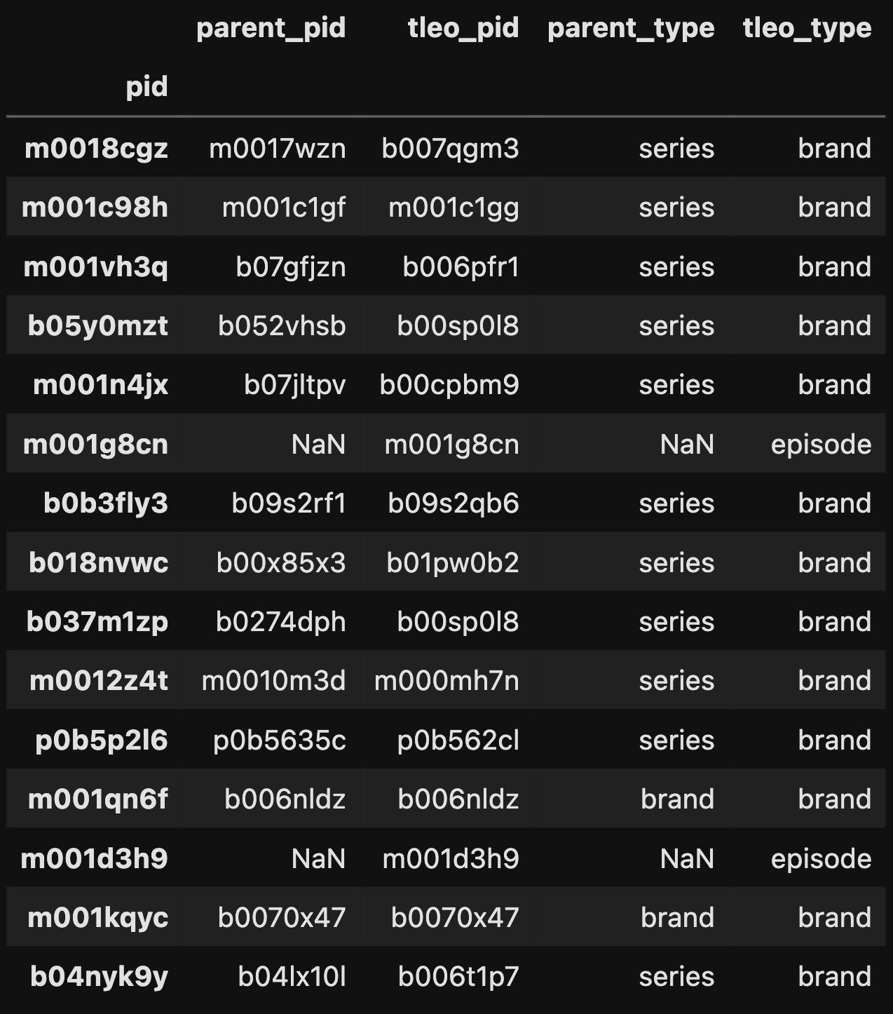
The Data
The iPlayer catalogue

Slide 40
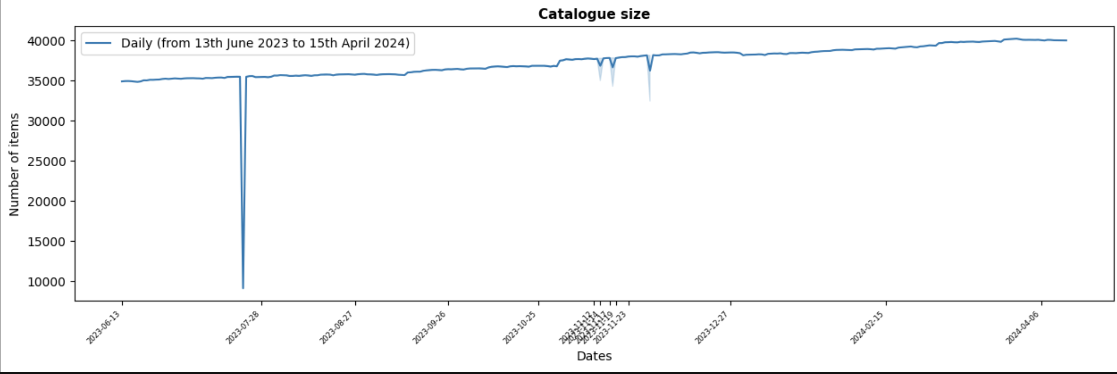
Catalogue size

Slide 41
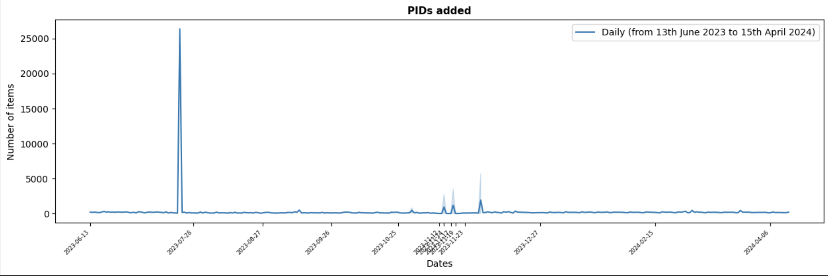
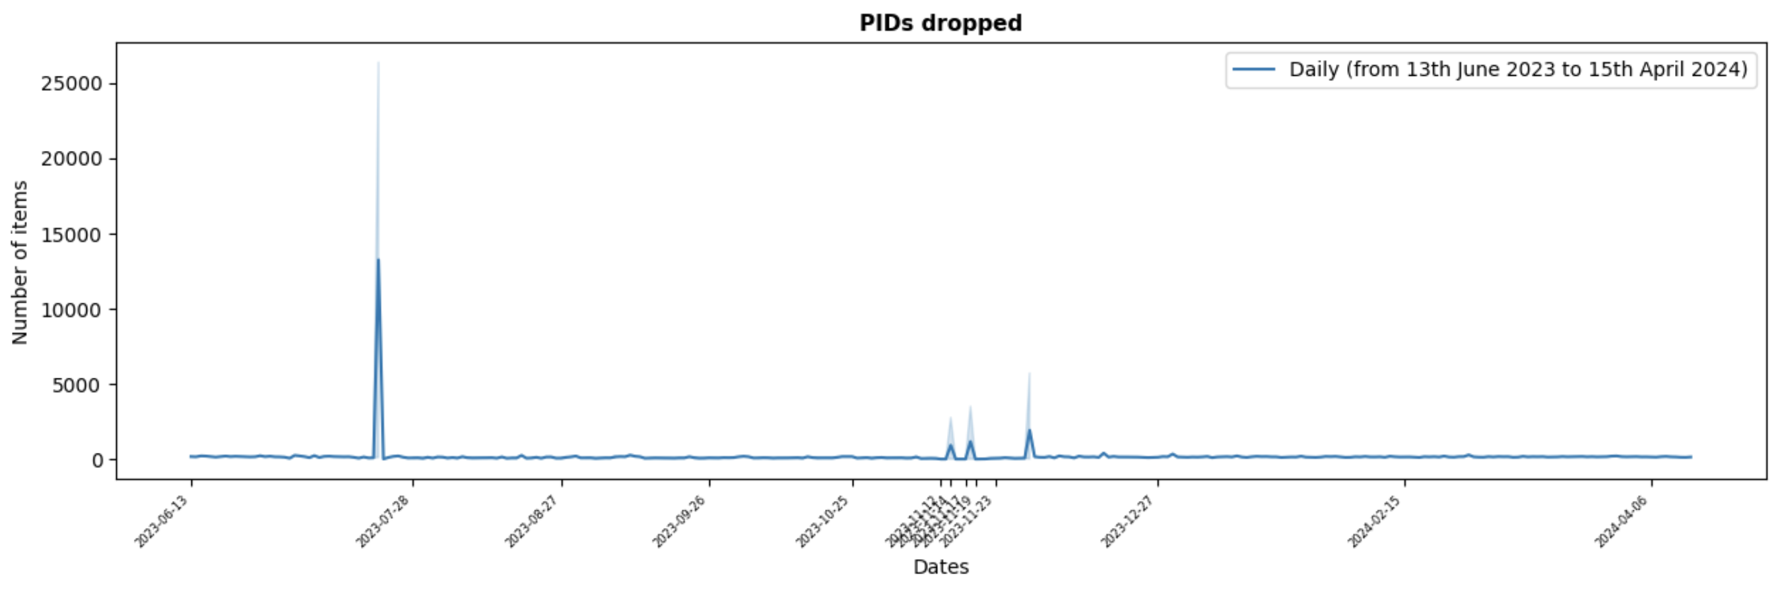
The Data

Slide 42
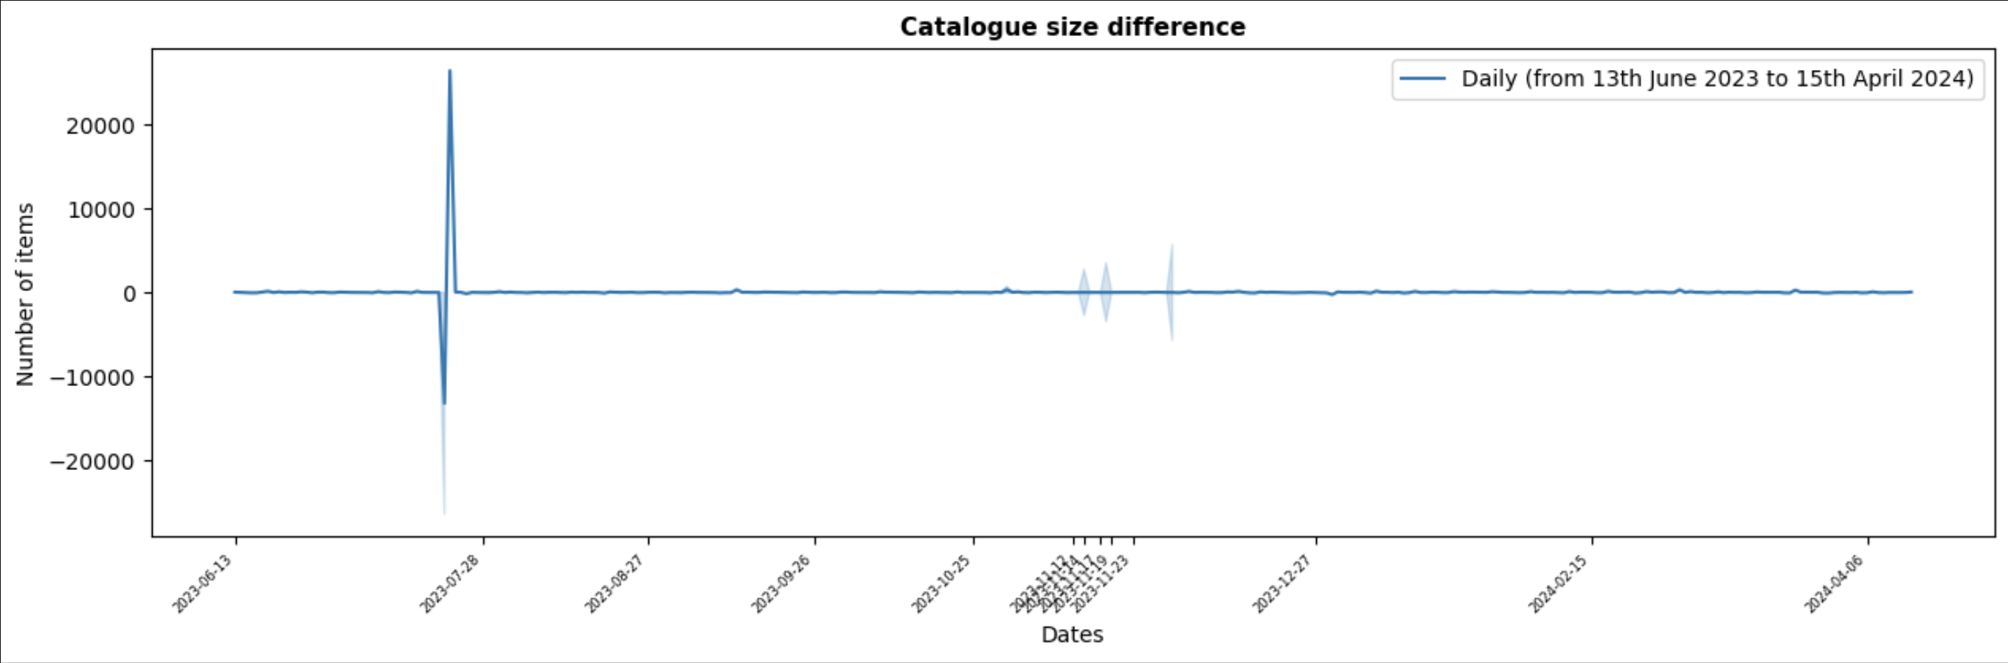
Data drift

Slide 43
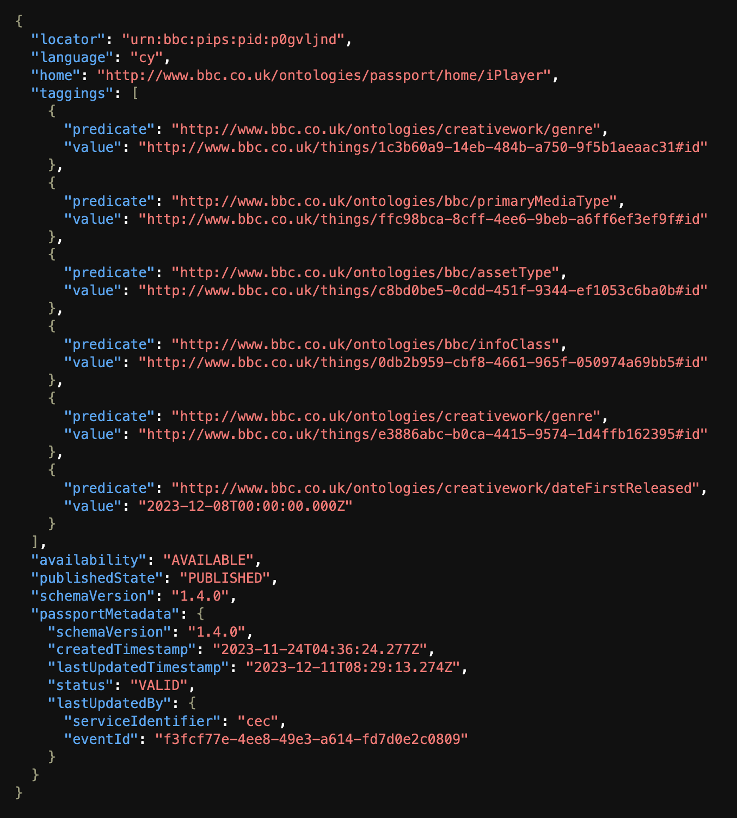
The Data
The Passport file

Slide 44
The Data
Passport Tags
Genre
Format
Contributor
Motivation
Editorial Tone
Narrative Theme
The selected Passport tags
Relevant To
About

Slide 45
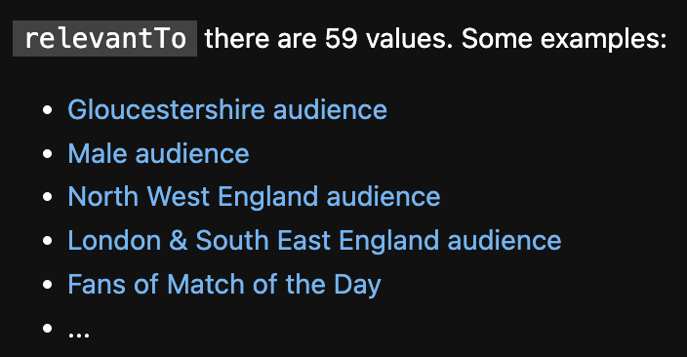
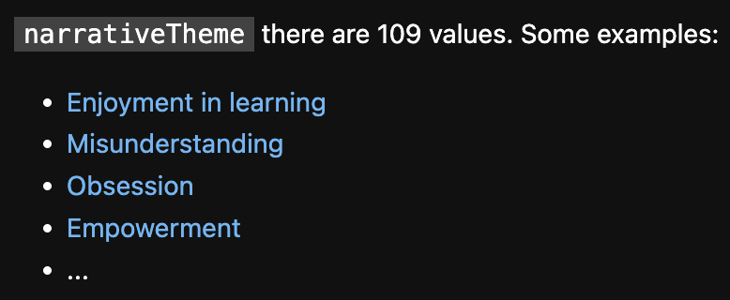
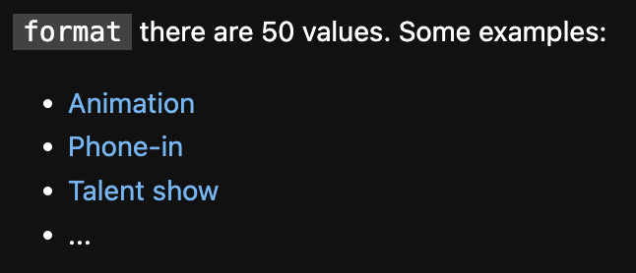
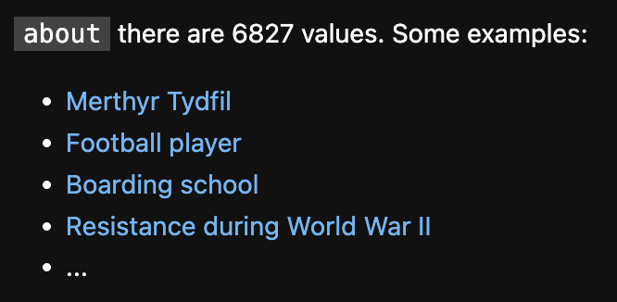
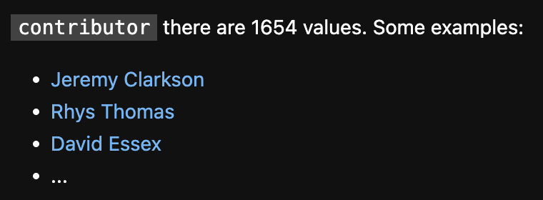

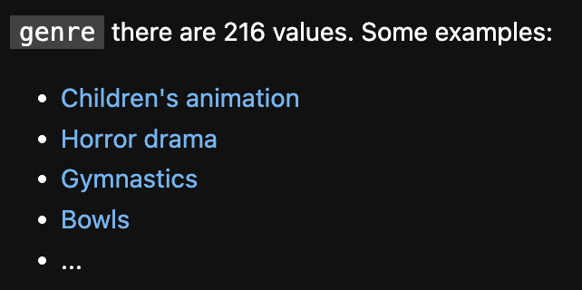
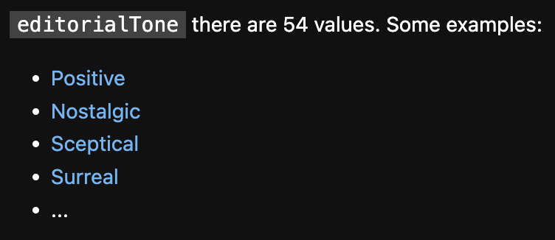
Passport tags: example values

Slide 46
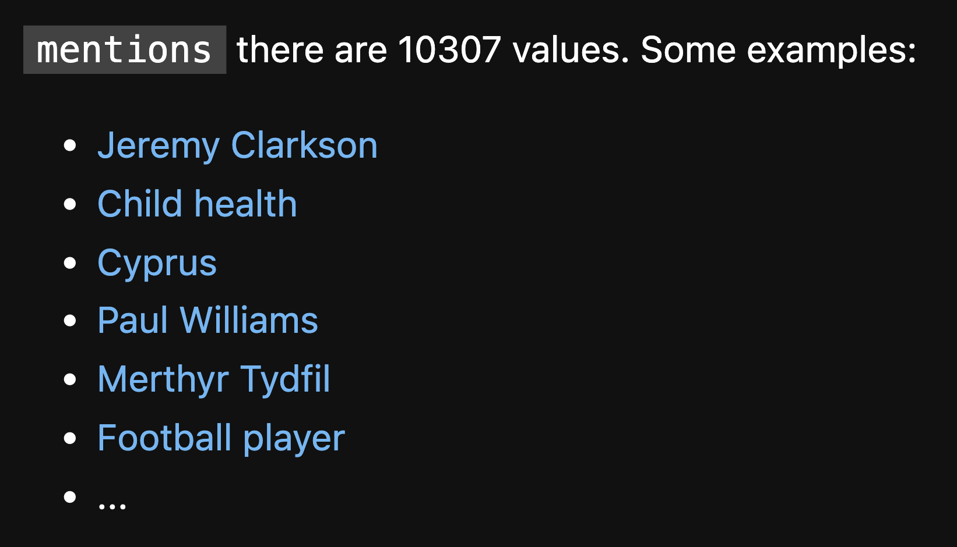
Source of bias

Slide 47
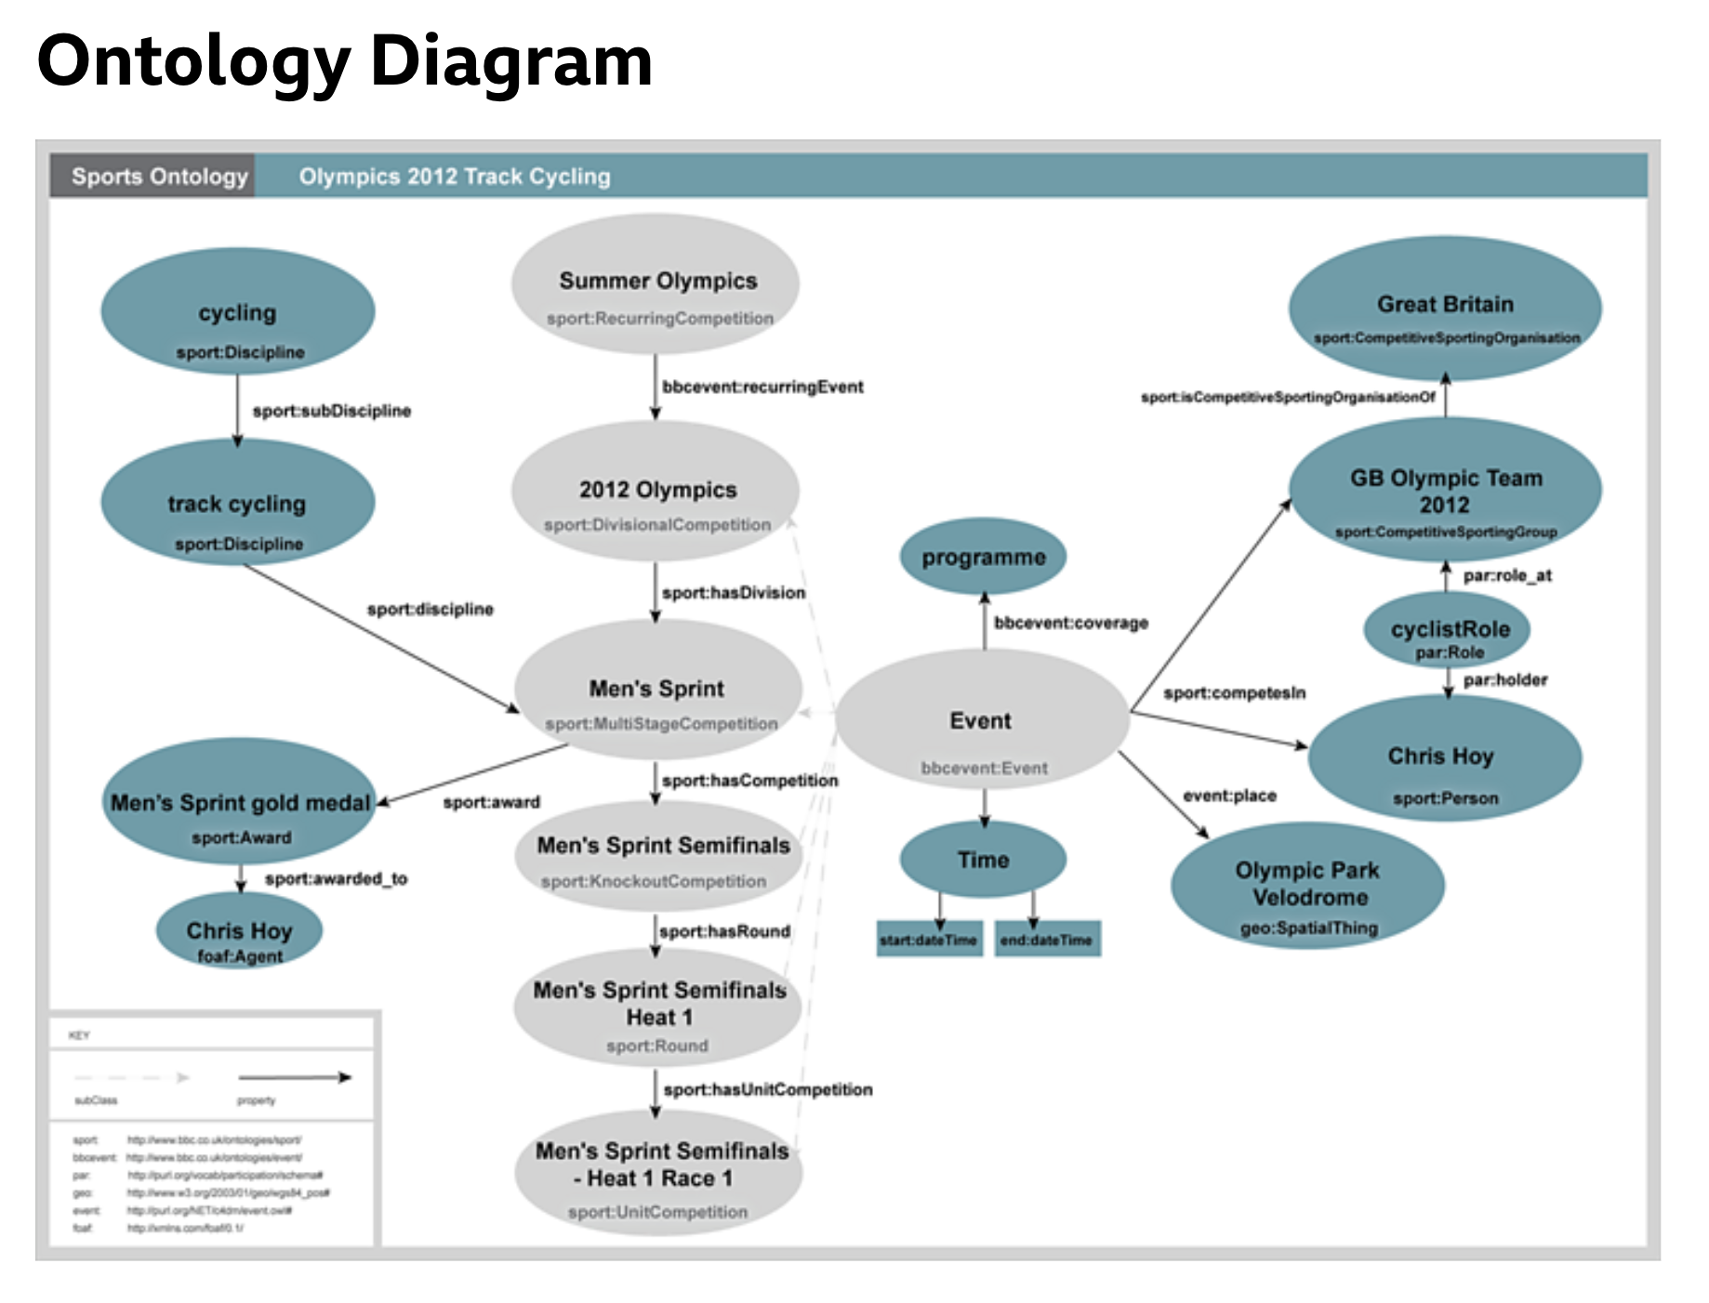
The Data
The BBC Ontologies

Slide 48
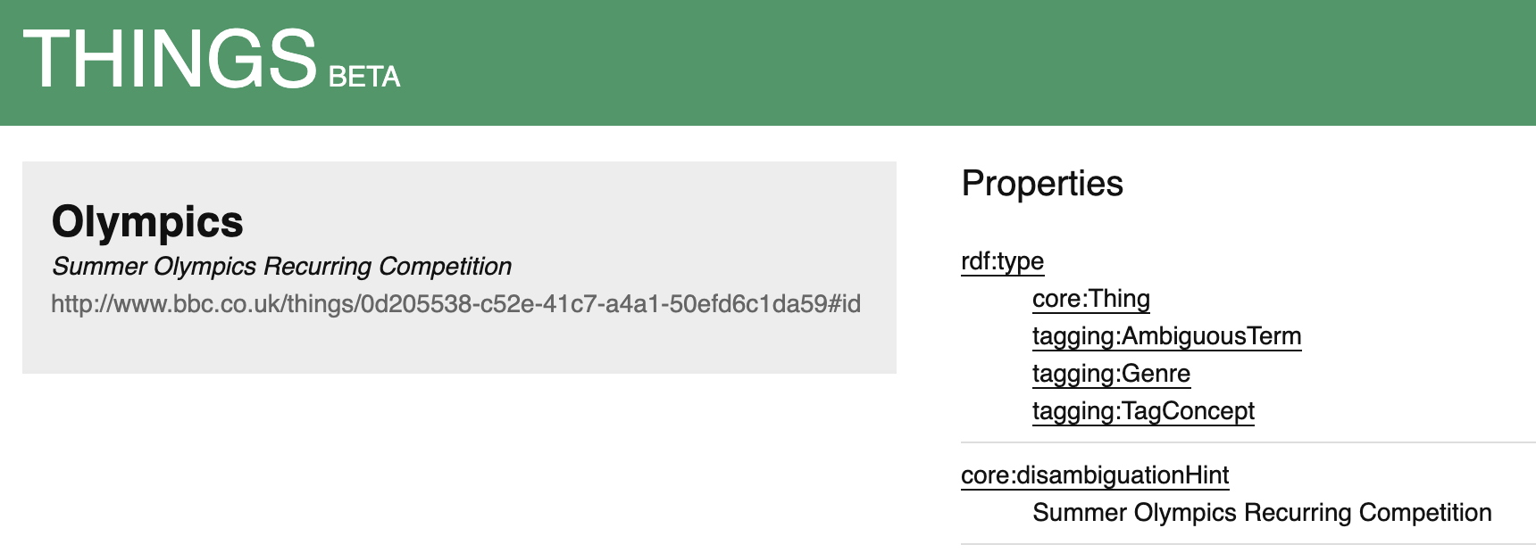
The Data
The BBC Things entities

Slide 49
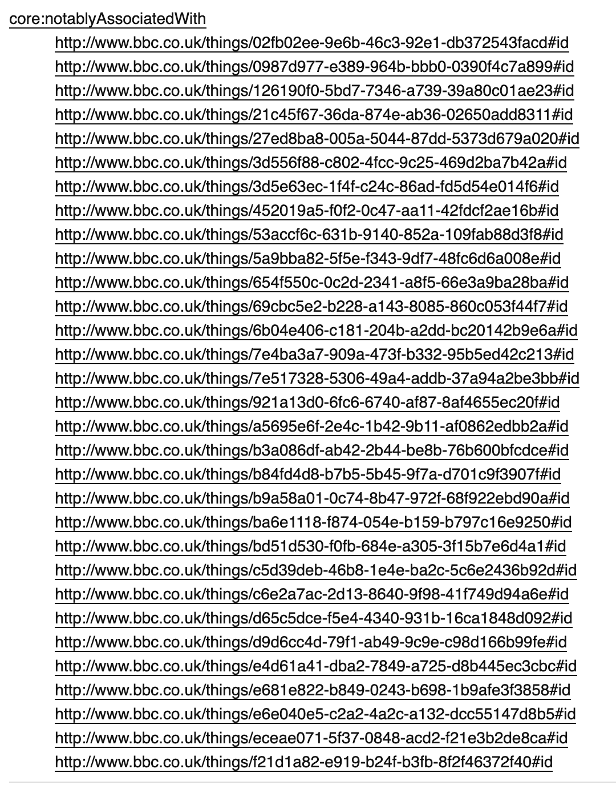
The Data
The BBC Things entities

Slide 50
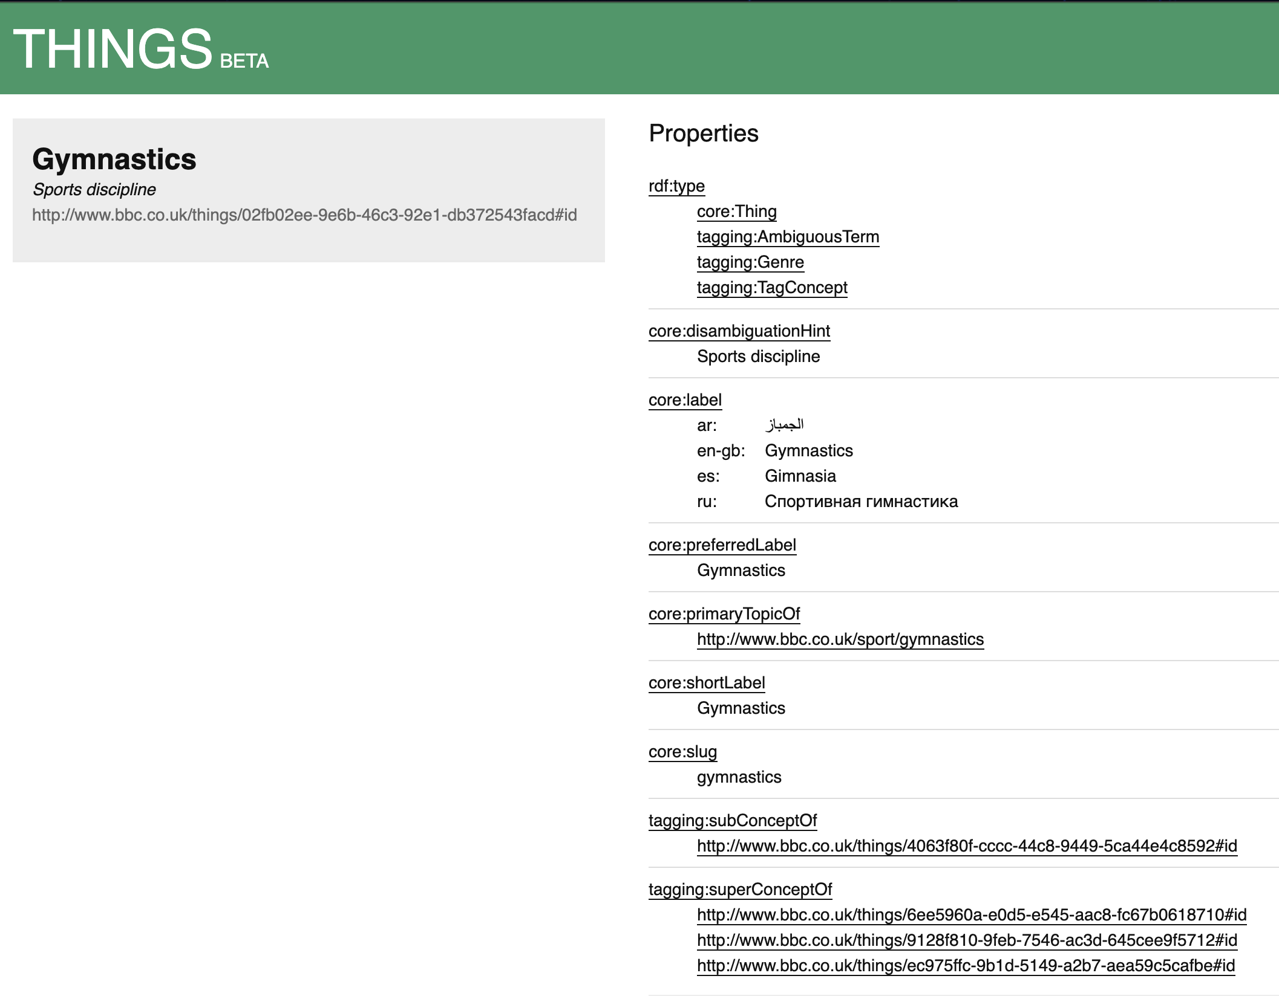
The Data
The BBC Things entities

Slide 51
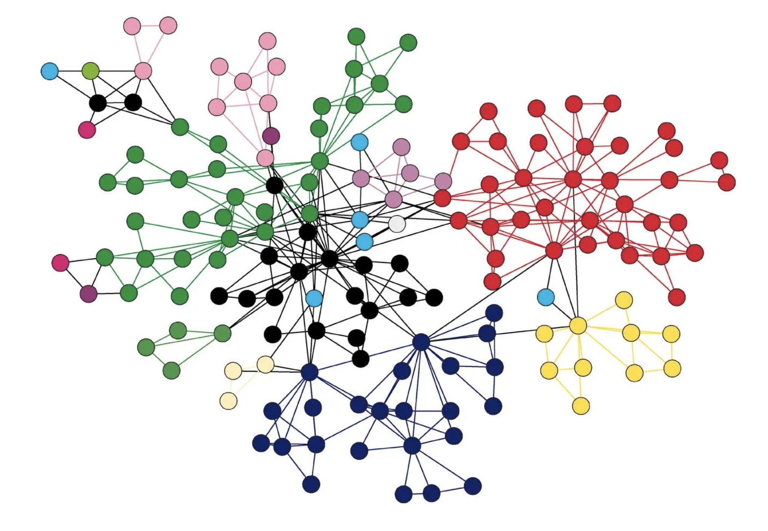
The (Linked) Data
Graph Data Structure

Slide 52
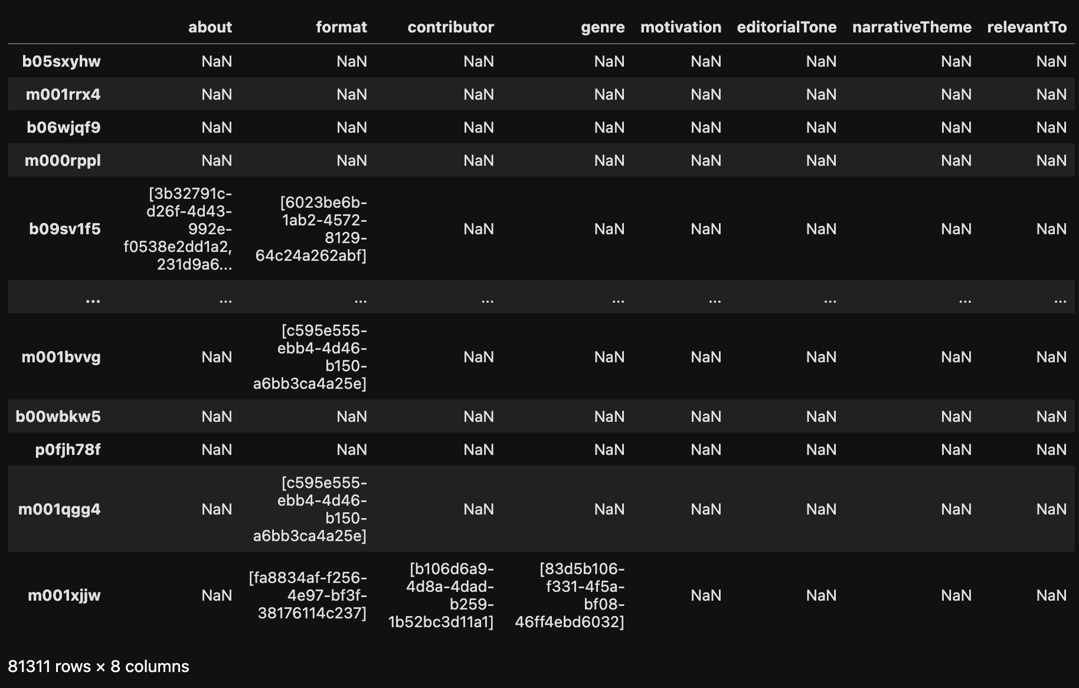
The Data: tradeoff

Slide 53
Implementation
Methods, justification, and tools used

Slide 54
















Tools

Slide 55
The Pipeline
Data Loading
Data Preprocessing
Modelling & Embeddings Generation
C2C Similarity Recommendation
Model Evaluation

Slide 56
The Pipeline
Data Loading

Slide 57
The Pipeline
Data Preprocessing

Slide 58

Data Preprocessing

Slide 59
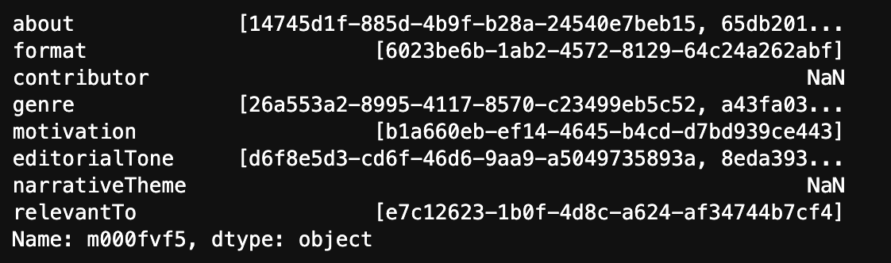
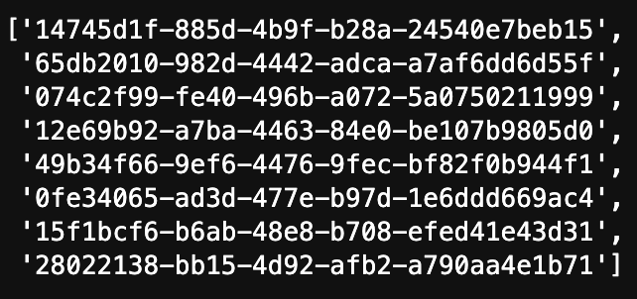
Data Preprocessing

Slide 60
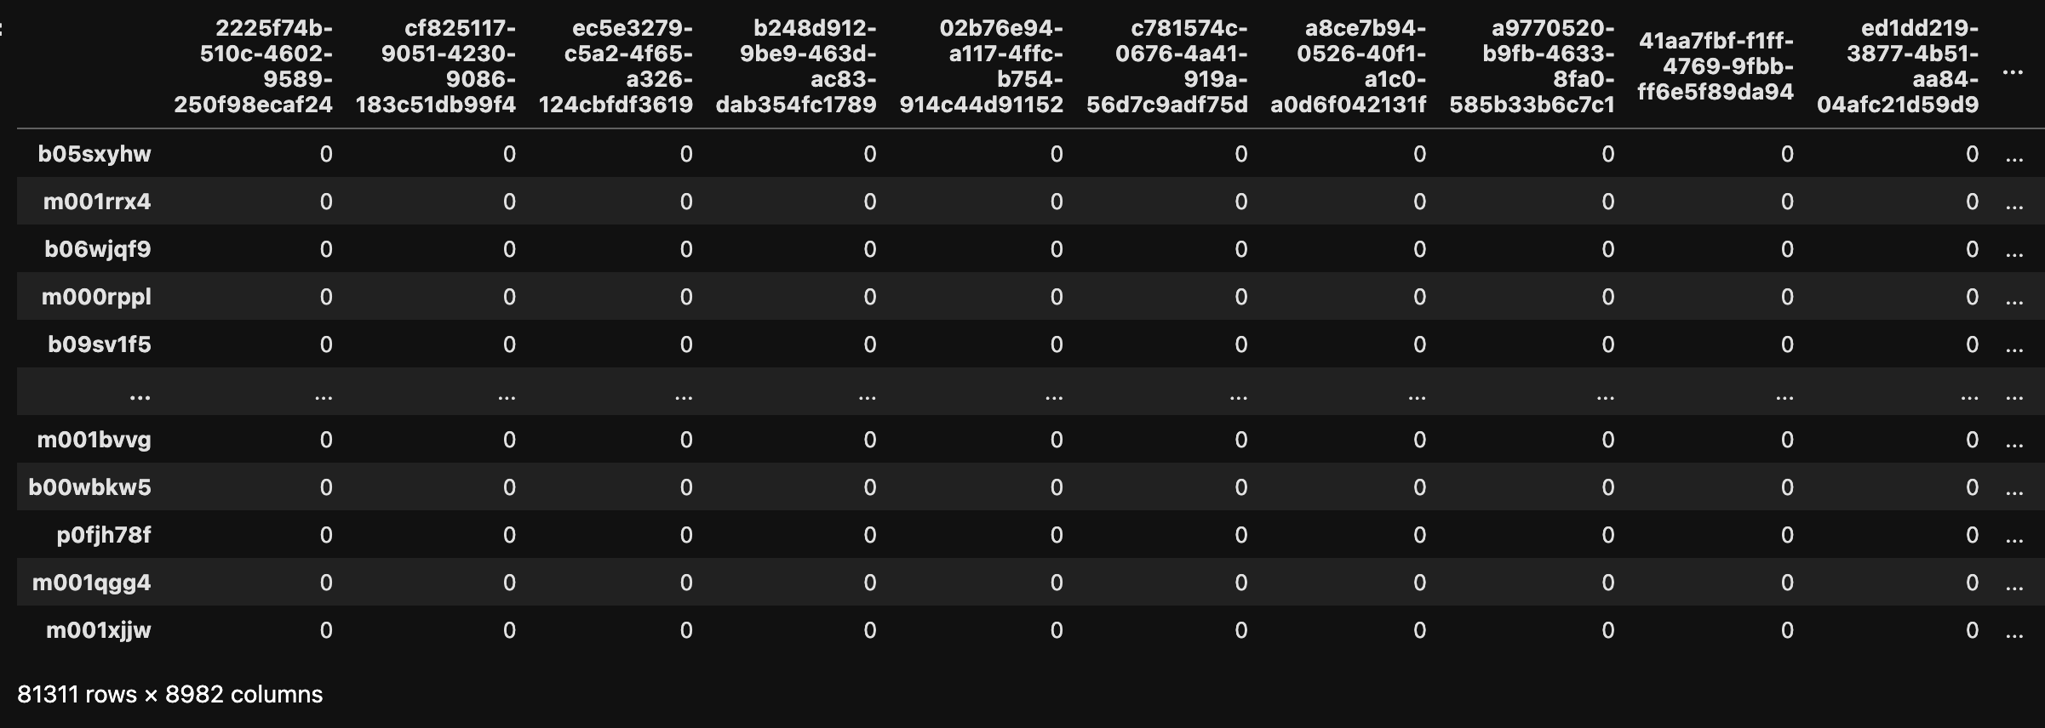
One-hot Encoded Dataset

Slide 61
The Pipeline
Modelling & Embeddings Generation

Slide 62

Modelling & Embeddings Generation

Slide 63
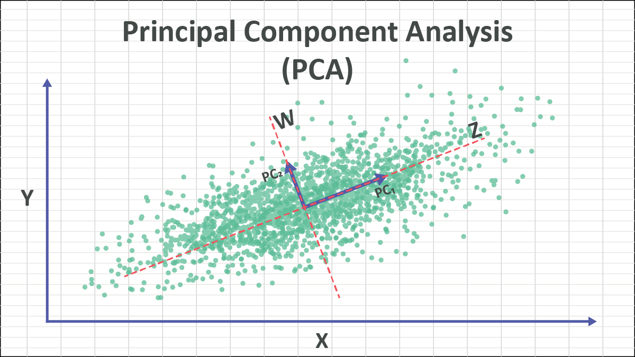
Modelling & Embeddings Generation

Slide 64
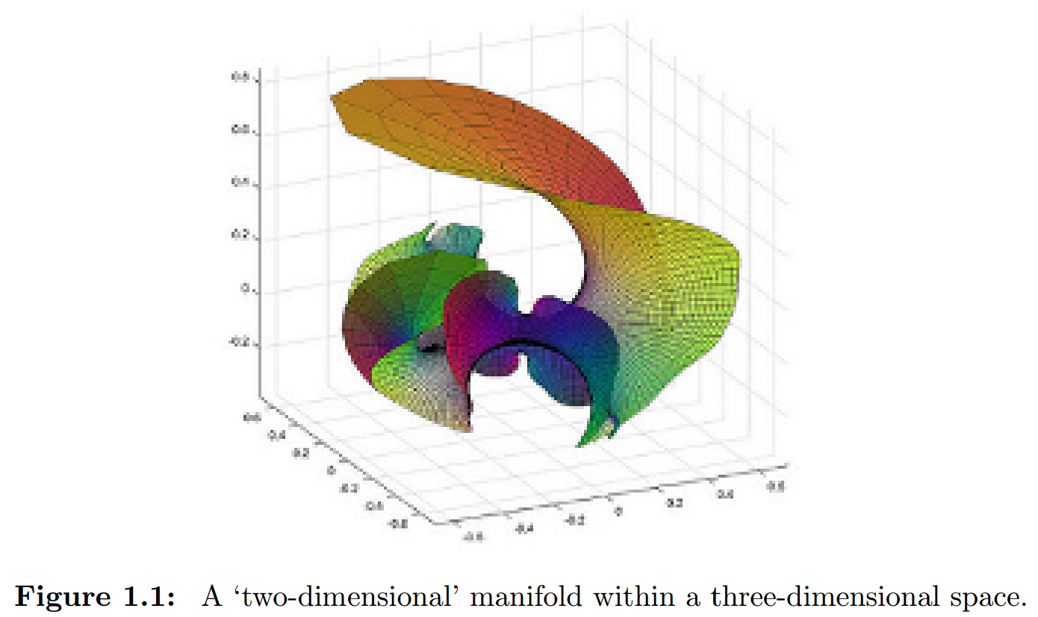
Modelling & Embeddings Generation

Slide 65
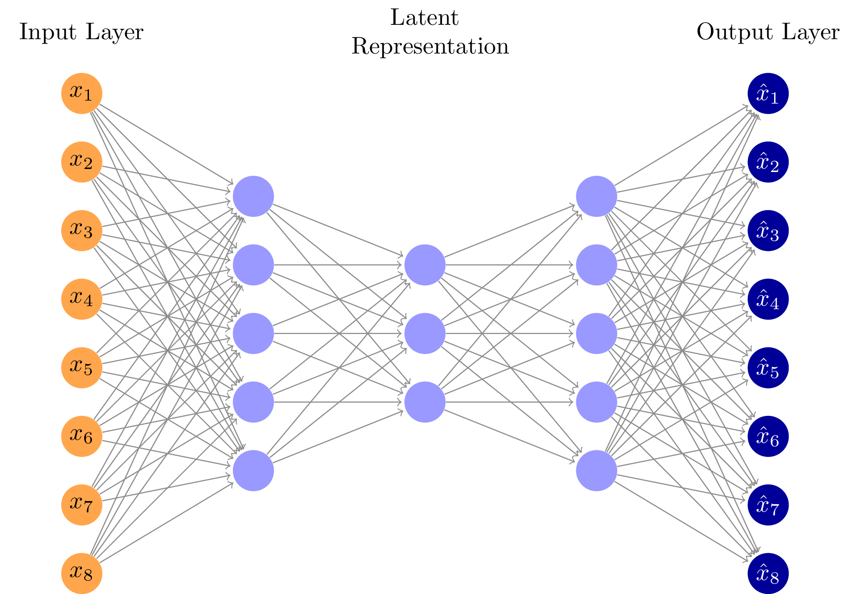
Modelling & Embeddings Generation

Slide 66
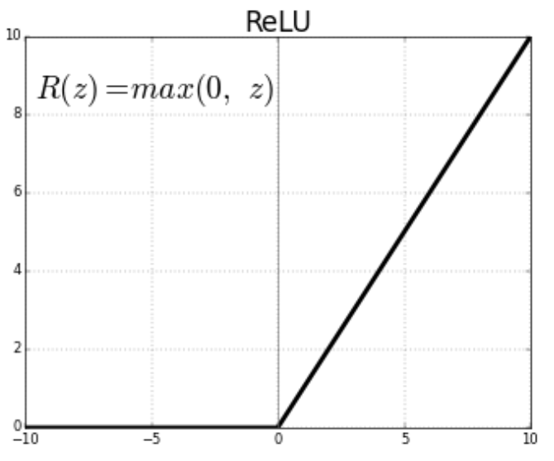
Modelling & Embeddings Generation

Slide 67
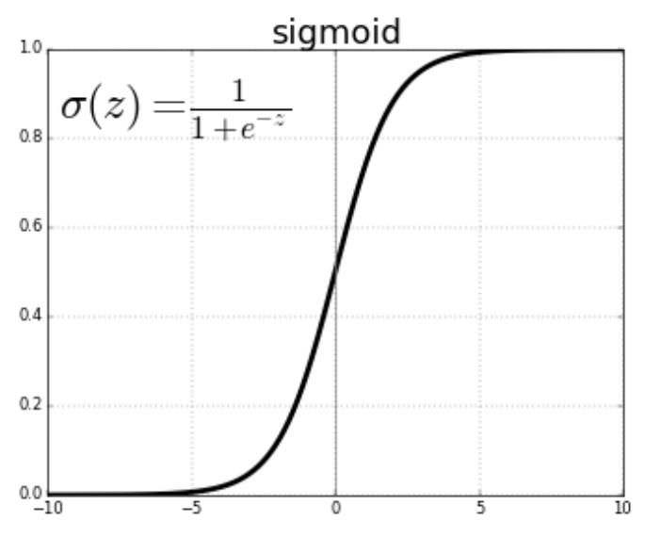
Modelling & Embeddings Generation

Slide 68
Data Split Ratio: 80%, 10%, 10%
Batch Size:
300
Epochs:
100
Optimizer:
Adam
Loss Function: Binary Cross Entropy
Early Stopping Patience:
10
Dropout Rate:
0.2
Modelling & Embeddings Generation

Slide 69
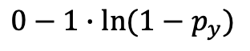
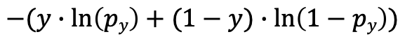
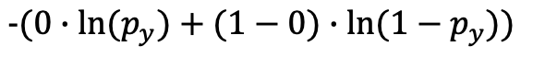
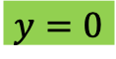
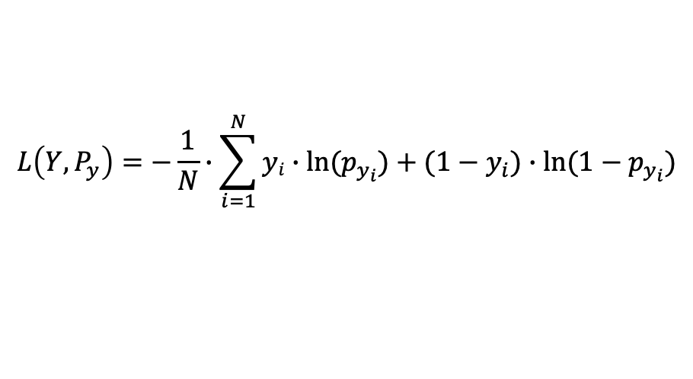

$$L\left(Y,P_{y}\right)=−\frac{1}{N}∙\sum_{i=1}^{N}{yi∙\ln{(p_{y_{i}}})+(1−y_{i})∙\ln{(1−p_{y_{i}})}}$$
Modelling & Embeddings Generation
let
$$−(y∙\ln\left(py\right)+(1−y)∙\ln\left(1−py\right))$$
and
$$y=0$$
$$-(0∙\ln{(p_{y}})+(1−0)∙\ln{(1−p_{y}))}$$
$$0−1∙\ln{(1−p_{y})}$$
$$−\ln{(1−p_{y})}$$

Slide 70
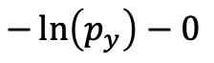
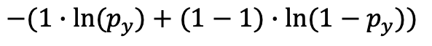
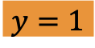

$$L\left(Y,P_{y}\right)=−\frac{1}{N}∙\sum_{i=1}^{N}{yi∙\ln{(p_{y_{i}}})+(1−y_{i})∙\ln{(1−p_{y_{i}})}}$$
Modelling & Embeddings Generation
let
$$−(y∙\ln\left(py\right)+(1−y)∙\ln\left(1−py\right))$$
and
$$y=1$$
$$−(1∙\ln{(p_{y}})+(1−1)∙\ln{(1−p_{y}))}$$
$$−\ln\left(p_{y}\right)−0$$
$$−\ln{(p_{y})}$$

Slide 71
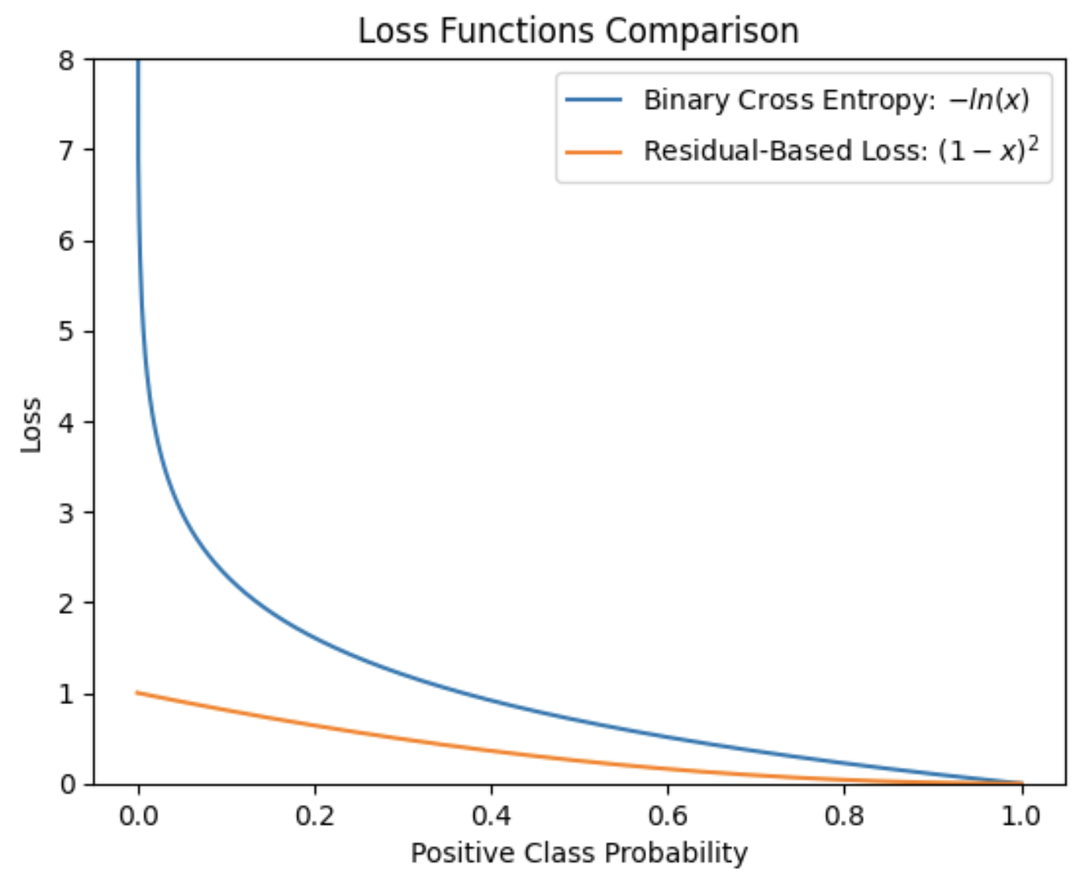
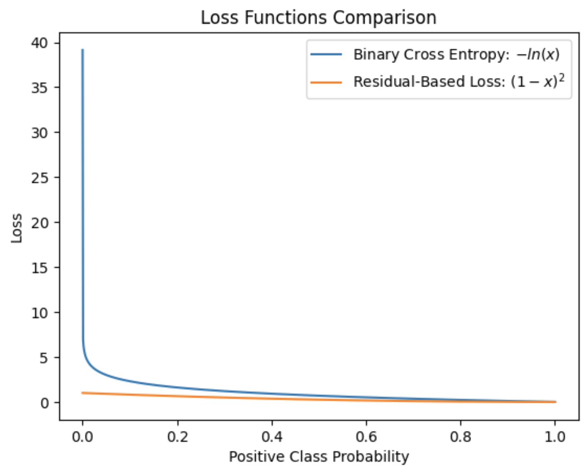
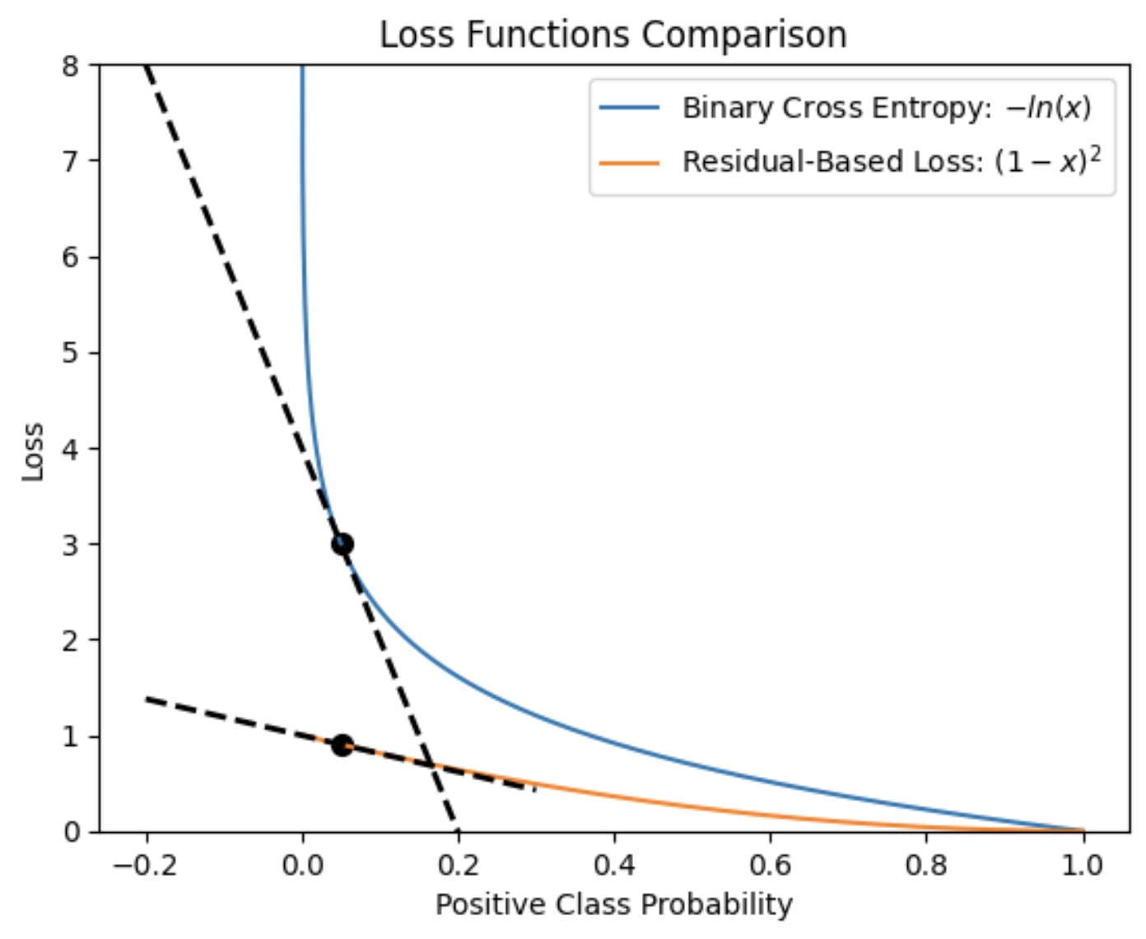
Modelling & Embeddings Generation

Slide 72
Learning Rate
Dropout
Batch Normalization
Modelling & Embeddings Generation

Slide 73
Modelling & Embeddings Generation
8982

Slide 74
Modelling & Embeddings Generation
8982
8982

Slide 75
Modelling & Embeddings Generation
n_hidden_layers

Slide 76
Modelling & Embeddings Generation
embeddings_size

Slide 77
Modelling & Embeddings Generation
n_nodes
n_nodes

Slide 78
Modelling & Embeddings Generation
N₂ < N₁
N₁ < 8982
N₁ < 8982
8982
N_{i} ∈ [4491, 2245, 1122, 561, 280, 140, ...]
8982

Slide 79
Modelling & Embeddings Generation
8982
N_{i} ∈ [4491, 2245, 1122, 561, 280, 140, ...]
8982

Slide 80
Modelling & Embeddings Generation
8982
N_{i} ∈ [4491, 2245, 1122, 561, 280, 140, ...]
8982

Slide 81
Modelling & Embeddings Generation
8982
N_{i} ∈ [4491, 2245, 1122, 561, 280, 140, ...]
8982

Slide 82
Modelling & Embeddings Generation
8982
N_{i} ∈ [4491, 2245, 1122, 561, 280, 140, ...]
8982

Slide 83
Modelling & Embeddings Generation
8982
N_{i} ∈ [4491, 2245, 1122, 561, 280, 140, ...]
8982

Slide 84
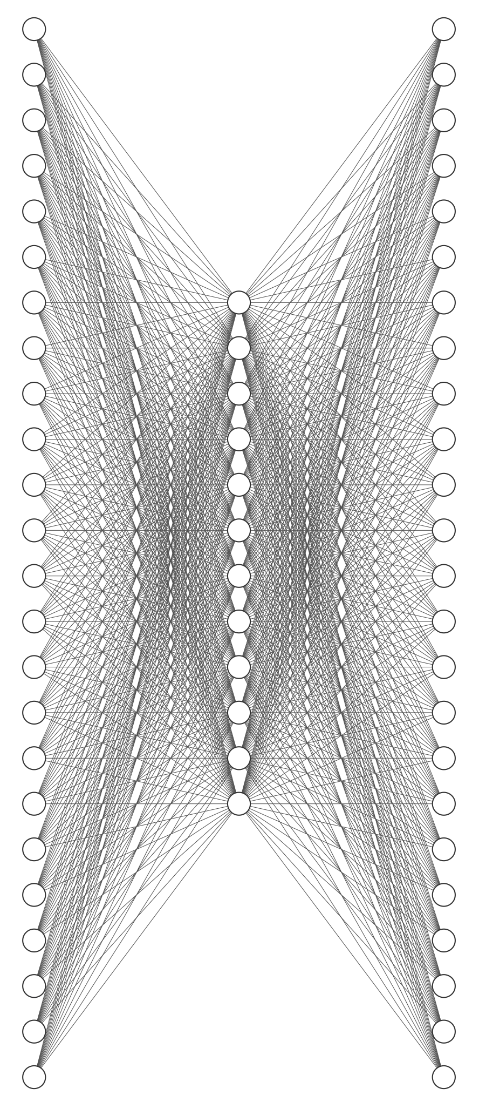
Modelling & Embeddings Generation
N_{i} ∈ [4491, 2245, 1122, 561, 280, 140, ...]

Slide 85
Modelling & Embeddings Generation
N_{i} ∈ [4491, 2245, 1122, 561, 280, 140, ...]

Slide 86
Modelling & Embeddings Generation
N_{i} ∈ [4491, 2245, 1122, 561, 280, 140, ...]

Slide 87
Modelling & Embeddings Generation
N_{i} ∈ [4491, 2245, 1122, 561, 280, 140, ...]

Slide 88
Modelling & Embeddings Generation
N_{i} ∈ [4491, 2245, 1122, 561, 280, 140, ...]

Slide 89

Modelling & Embeddings Generation
N_{i} ∈ [4491, 2245, 1122, 561, 280, 140, ...]

Slide 90
Modelling & Embeddings Generation
N_{i} ∈ [4491, 2245, 1122, 561, 280, 140, ...]

Slide 91
Modelling & Embeddings Generation
N_{i} ∈ [4491, 2245, 1122, 561, 280, 140, ...]

Slide 92
Modelling & Embeddings Generation
N_{i} ∈ [4491, 2245, 1122, 561, 280, 140, ...]

Slide 93
Modelling & Embeddings Generation
N_{i} ∈ [4491, 2245, 1122, 561, 280, 140, ...]

Slide 94
Modelling & Embeddings Generation
N_{i} ∈ [4491, 2245, 1122, 561, 280, 140, ...]

Slide 95
N. Hidden Layers: 1
Embedding Size: 561
Batch Normalization: False
Dropout: True
Learning Rate: 0.01
Modelling & Embeddings Generation

Slide 96

Modelling & Embeddings Generation

